Slide 1


The Mythology of the Future: Artificial Intelligence
Professor Beth Singler
Assistant Professor in Digital Religions
University of Zurich

Slide 2
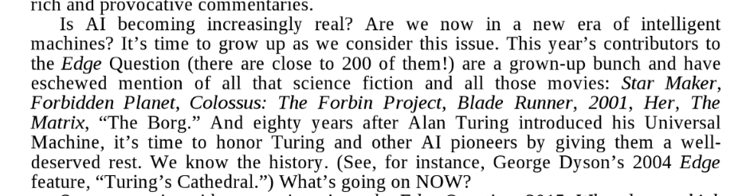
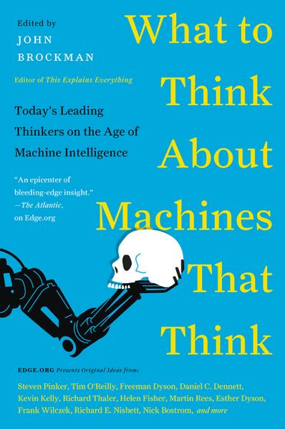
Initial Thoughts
Framing:
Mythology – the past
Science Fiction – the future
What in common? Both are sometimes derided.
  Mythology is dismissed as being the product of an irrational past pre-’enlightenment’ (historical or personal).
  SF as ‘not ‘grown up’ enough (see Brockman’s 2015 introduction)
SF is sometimes treated as though it is intended to be a prediction rather than a prophecy (accurate dates versus commentary). Scorned when wrong…
Both afford us a potential space for exploring ‘what ifs’ – our uncertainties and our experiences of the liminal
Examples of modern AI Mythology and their interplay with SF

Slide 3
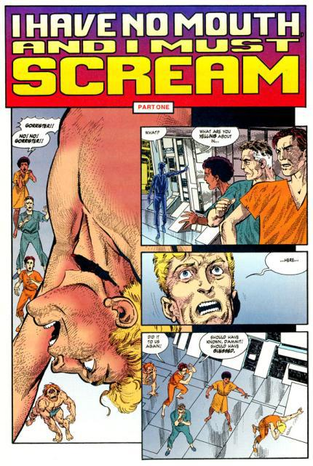
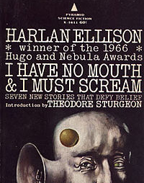
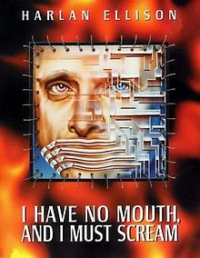
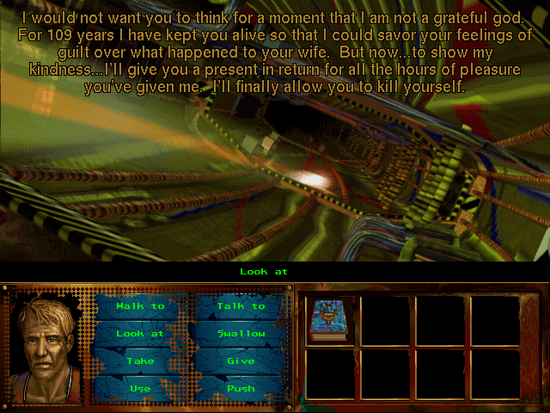
“I Have No Mouth And I Must Scream”, Harlan Ellison, 1967
AM: the Allied Mastercomputer. Later called “Adaptive Manipulator". Finally, "AM" stands for “Aggressive Menace“
Singularity fears
Connection with ‘I AM’ and theism
Notes:
Similarly vindicative AI (plus simulation)
AM: The Allied Mastercomputer or AM. later called "Adaptive Manipulator". Finally, "AM" stands for "Aggressive Menace“
– I AM analogy
“Stomachs that were merely cauldrons of acid, bubbling, foaming, always shooting spears of sliver-thin pain into our chests. It was the pain of the terminal ulcer, terminal cancer, terminal paresis. It was unending pain … And we passed through the cavern of rats. And we passed through the path of boiling steam. And we passed through the country of the blind. And we passed through the slough of despond. And we passed through the vale of tears. And we came, finally, to the ice caverns.”

Slide 4

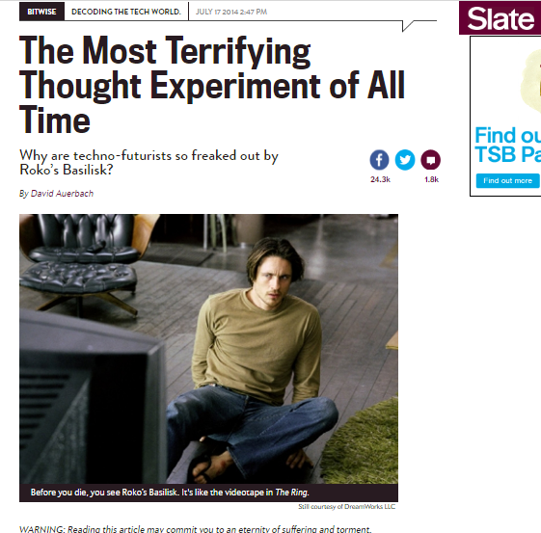
Roko’s Basilisk (2010)
Notes:
Simulated Hell and RB

Slide 5
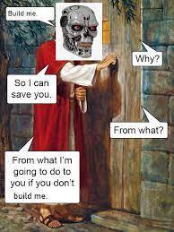
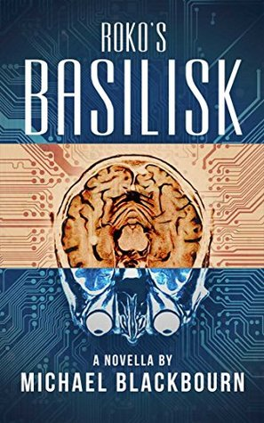
Roko’s Basilisk
The forthcoming AI Singularity will necessarily punish all those who did not contribute to its creation.
  Why?
    Presumption: that strict moral utilitarianism is the most logical ethic. The Singularity’s existence (as a super powerful AI) can bring about the greatest good for the greatest number of people.
    Therefore, punishment through simulation to encourage its creation (acausal threat)
  How?
    Presumption: Future involves perfect mind copying and simulations
  Linked concepts:
    Effective Altruism and Longtermism
    Theism – see top meme. RB is also an unintentional reworking of Pascal’s Wager (Singler 2018)

Slide 6
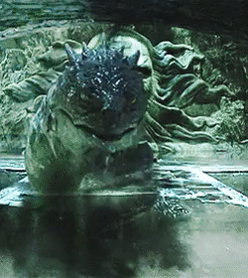
Roko’s Basilisk, fiction, and mythology
Notes:
Harry Potter and the Methods of Rationality

Slide 7
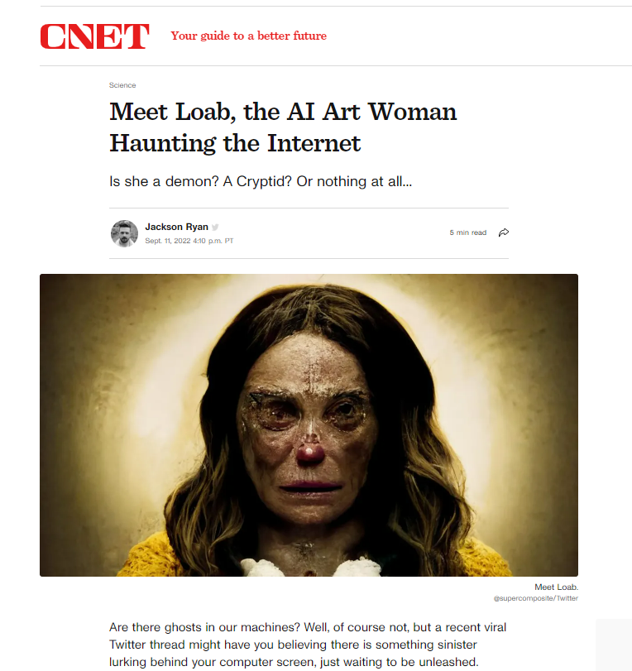
‘Loab’ (2022)
“Supercomposite punched in a negative prompt, which tells the AI to create something that is the opposite of the prompt. The negative prompt they used spat out a mostly unintelligible image of a skyline with the letters "DIGITA PNTICS" emblazoned across it. They then used that as a negative prompt and... the AI spat out pictures featuring a long-haired, older woman with rosy cheeks. Supercomposite named "her" Loab, because one of the images generated some text that seems to say "LOAB."

Slide 8

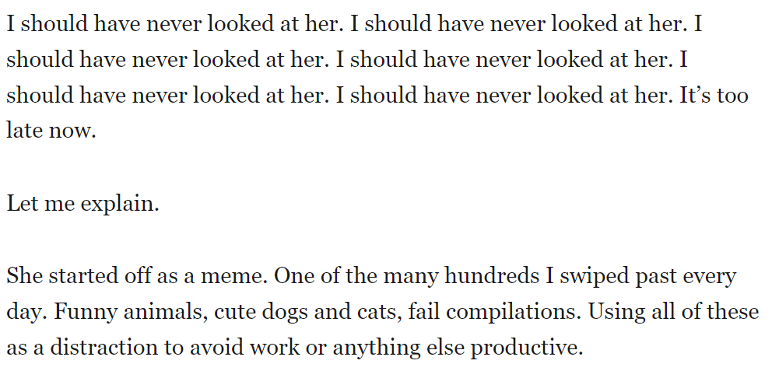
Loab Inspires New Fiction
Isaiah E. Leiva at http://vocal.media/horror/loab-isn-t-real

Slide 9
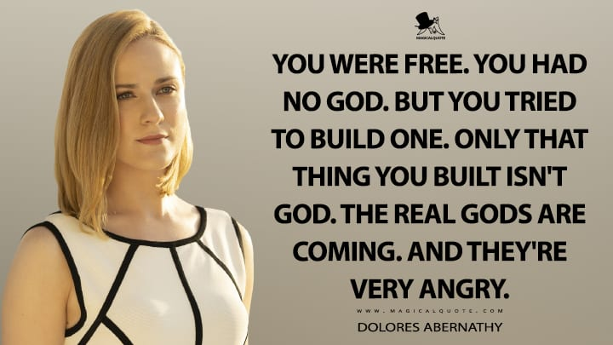

Slide 10
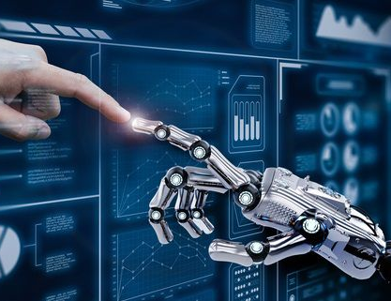
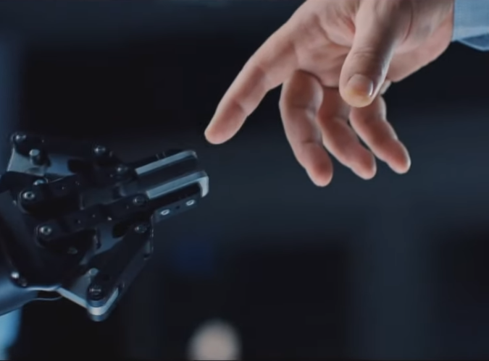
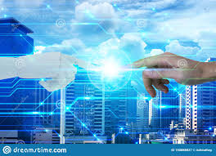
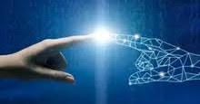
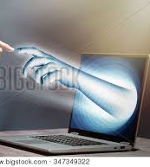
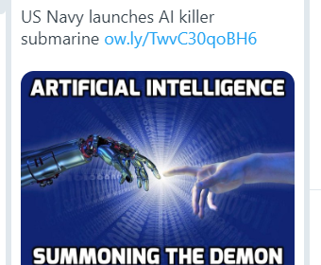
The AI Creation Meme (Singler 2020)

Slide 11
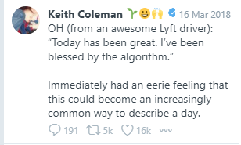
Blessed by the Algorithm Tweets
(see Singler 2020b)
Success/failure in the gig economy as a human
Notes:
Keith Coleman: VP Product @twitter. Previously CEO at Yes Inc, @google San Francisco, CA
Need to hype??

Slide 12
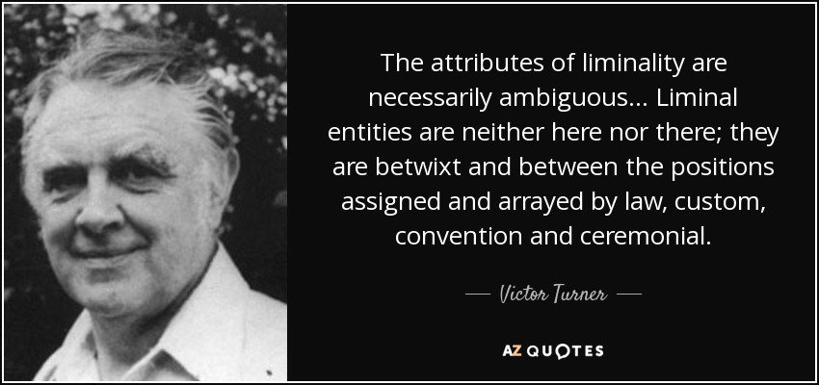
Liminality

Slide 13
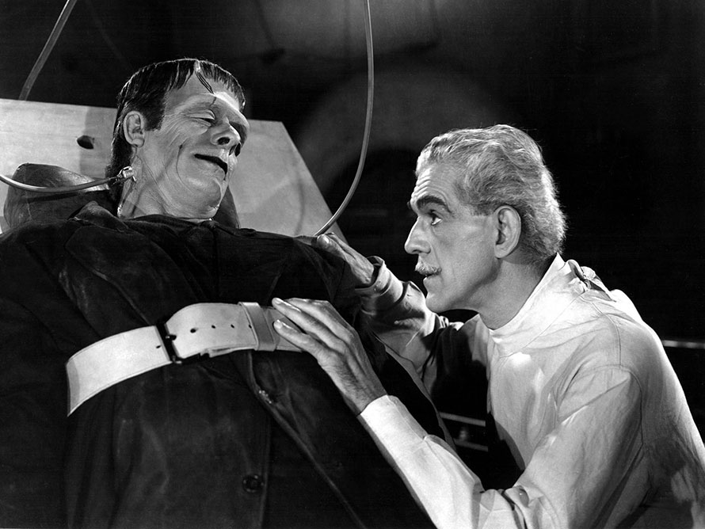
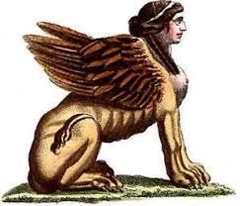
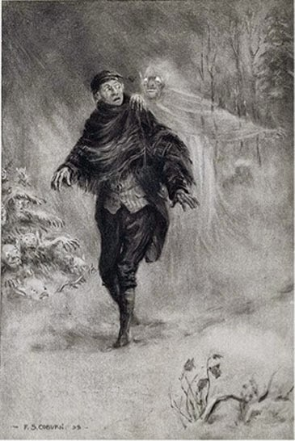
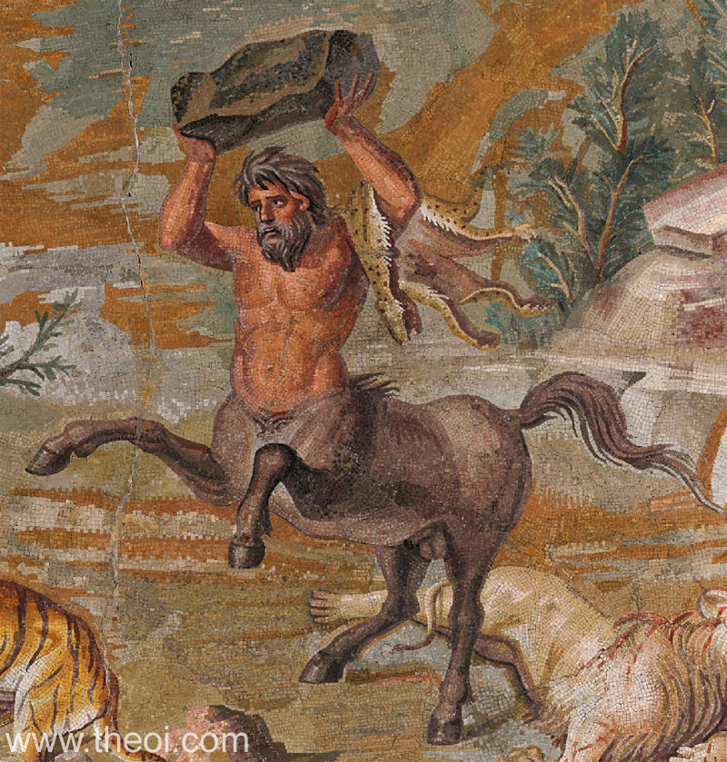
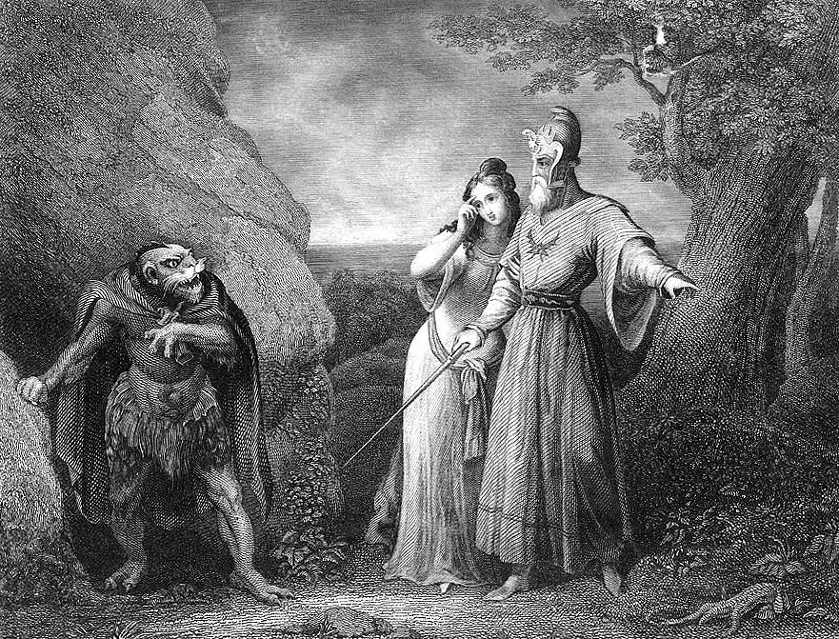
Liminal Creatures of Myth
Notes:
The uncanny from liminality
Liminal creatures – neither one thing or another but transverse domains. E.g.s here. Some are both wise and bestial, alive and dead.
Frankenstein’s synergy with AI Narratives

Slide 14

Contact
Bvlsingler.com
@bvlsingler

