Slide 1
Are We Ready for Artificial Intelligence?
Dr Beth Singler
Junior Research Fellow in Artificial Intelligence, Homerton College, University of Cambridge

Slide 2
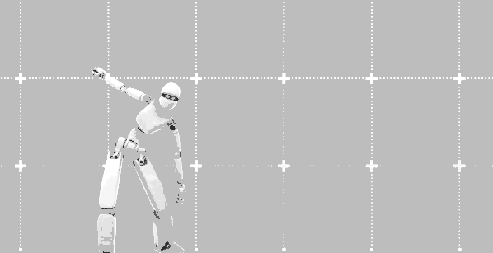
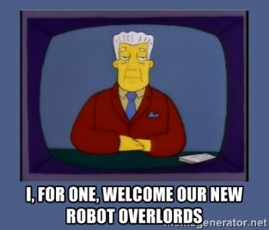
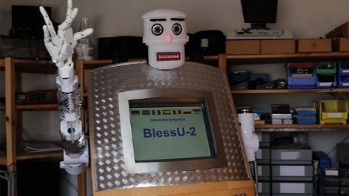
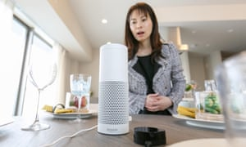

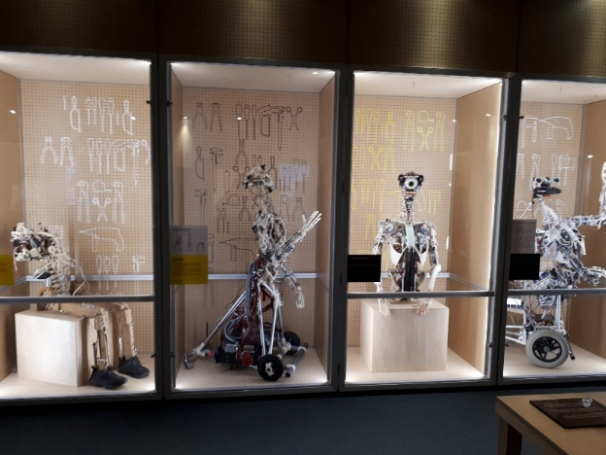
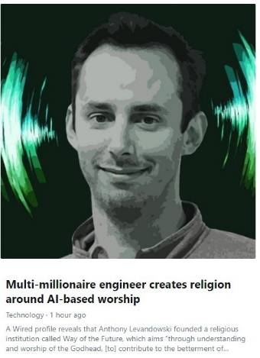
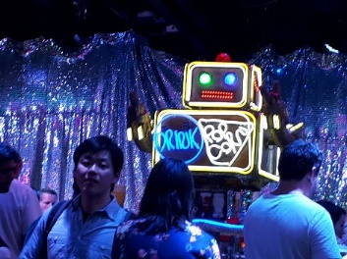
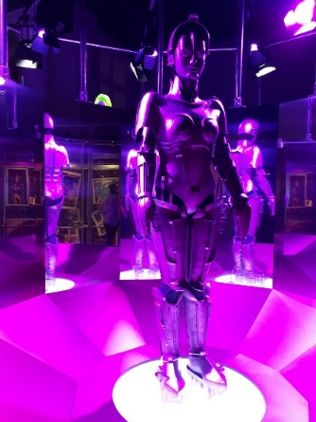
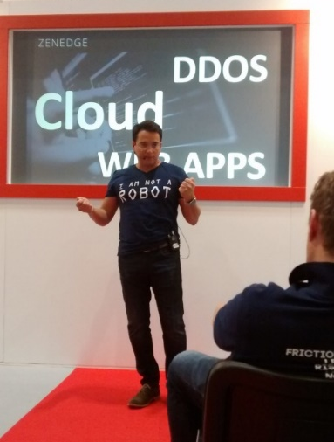
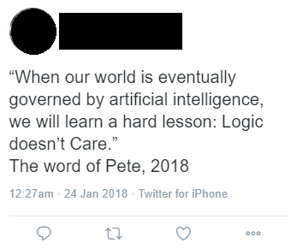
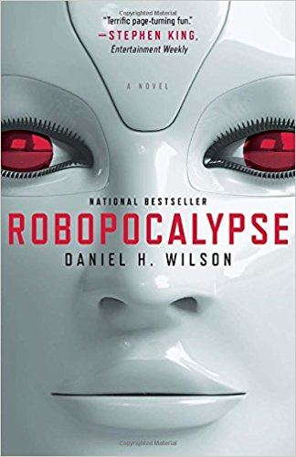
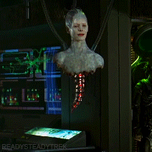
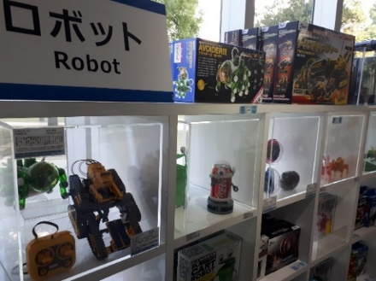

Notes:
I think about what you (as in the publics) think about machines that might think

Slide 3
Introduction
1. What is AI?
2. What is AI doing right now?
3. What changes are likely because of AI?
4. Will the robots kill us all?

Slide 4





1. What is Artificial Intelligence?

Slide 5
1. What is Artificial Intelligence?
COMPUTE
DATA
MODEL
OUTPUT

Slide 6
1. What is Artificial Intelligence?
COMPUTE
DATA
MODEL
OUTPUT

Slide 7
1. What is Artificial Intelligence?
COMPUTE
DATA
MODEL
OUTPUT

Slide 8
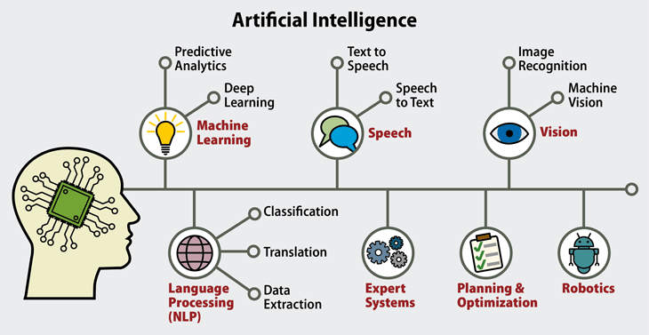
What is AI?

Slide 9
What is AI?
Synthetic brain/machine mind

Slide 10
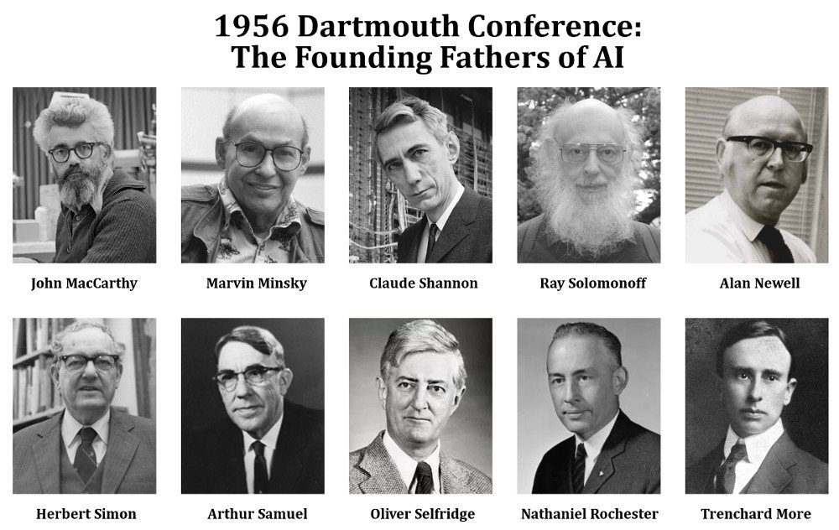
Notes:
Origin of term ‘AI’ – Darmouth college meeting 1956. Outlined their aims for the technology.

Slide 11

The Research Proposal
“We propose that a 2-month, 10-man study of artificial intelligence be carried out during the summer of 1956 at Dartmouth College in Hanover, New Hampshire. The study is to proceed on the basis of the conjecture that every aspect of learning or any other feature of intelligence can in principle be so precisely described that a machine can be made to simulate it. An attempt will be made to find how to make machines use language, form abstractions and concepts, solve kinds of problems now reserved for humans, and improve themselves. We think that a significant advance can be made in one or more of these problems if a carefully selected group of scientists work on it together for a summer.”
Notes:
Relate to the transhumanist idea of man as machine – RE Julien Offray de La Mettrie, Man as Machine

Slide 12
The Research Proposal
“We propose that a 2-month, 10-man study of artificial intelligence be carried out during the summer of 1956 at Dartmouth College in Hanover, New Hampshire. The study is to proceed on the basis of the conjecture that every aspect of learning or any other feature of intelligence can in principle be so precisely described that a machine can be made to simulate it. An attempt will be made to find how to make machines use language, form abstractions and concepts, solve kinds of problems now reserved for humans, and improve themselves. We think that a significant advance can be made in one or more of these problems if a carefully selected group of scientists work on it together for a summer.”
Notes:
Relate to the transhumanist idea of man as machine – RE Julien Offray de La Mettrie, Man as Machine

Slide 13

What is ‘Intelligence’?
Computer scientists ‘looked around at who the smartest people were, and they were themselves, of course. They were all essentially mathematicians by training, and mathematicians do two things – they prove theorems and play chess. And they said, hey, if it proves a theorem or plays chess, it must be smart.’ Robert Wilensky, Compulsive Technology: Computers as Culture (1985).

Slide 14
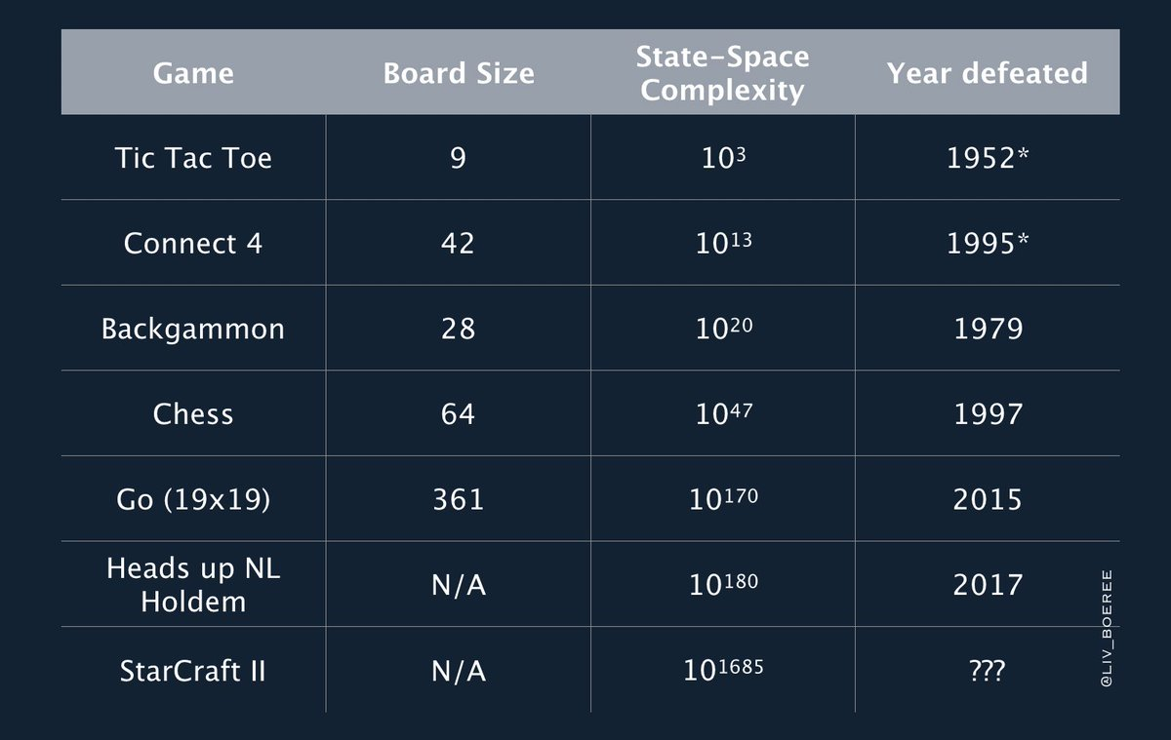
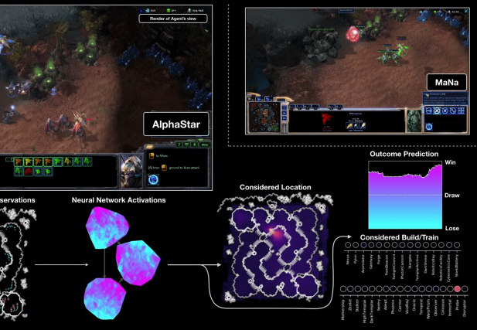
AI and Games
*NB Starcraft II was WoN 11-1 by Alphastar on 24th January 2019
*

Slide 15
2. What is AI Doing Right Now?

Slide 16
How many of you think you use technology powered with AI?

Slide 17
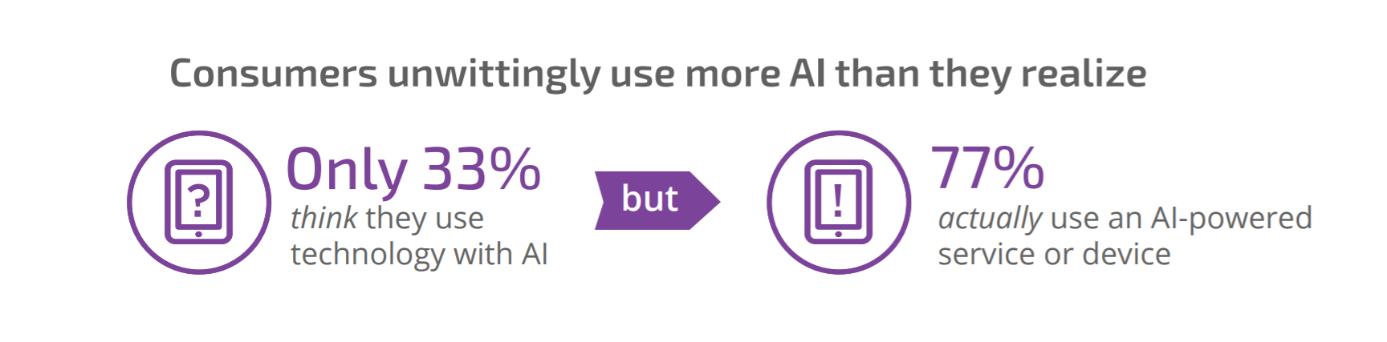
How many of you think you’ve interacted with Artificial Intelligence?
Pega survery,
What Consumers Really Think About AI, 2017
6,000 global consumers

Slide 18
Current Uses of AI
Finance
Hospitals and medicine
Heavy Industry
Online/social media
Retail
Manufacturing
Self-driving vehicles
Marketing
eCommerce
AI assistants
Smart homes tech
Computer games
Art
Music
Cybersecurity
Weapons systems
Forecasting
Speech to text
Scientific modelling

Slide 19
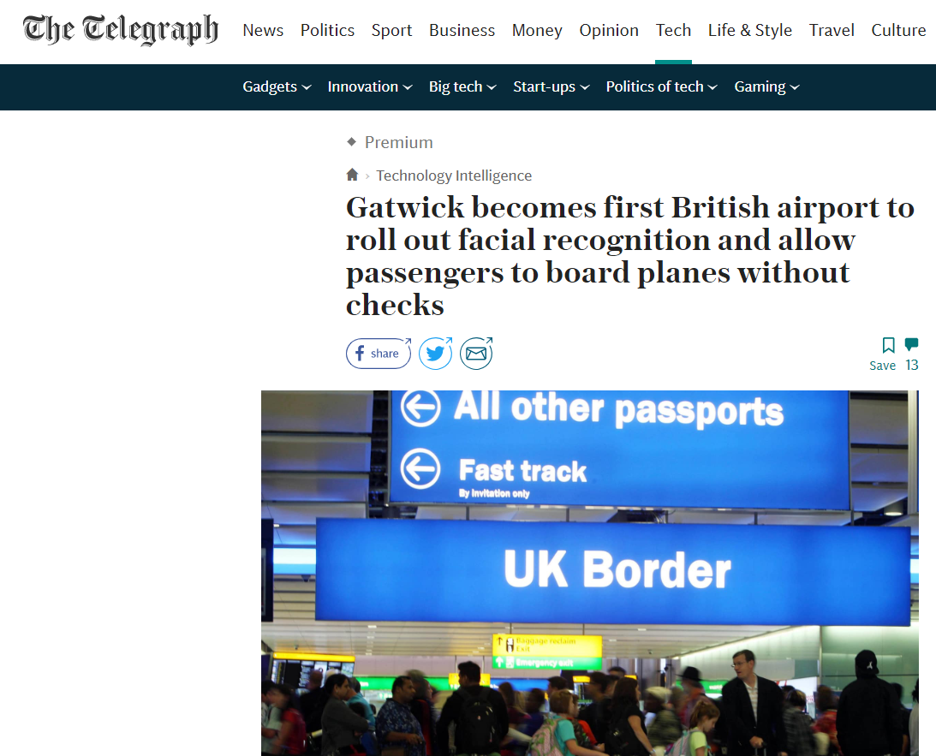

Slide 20
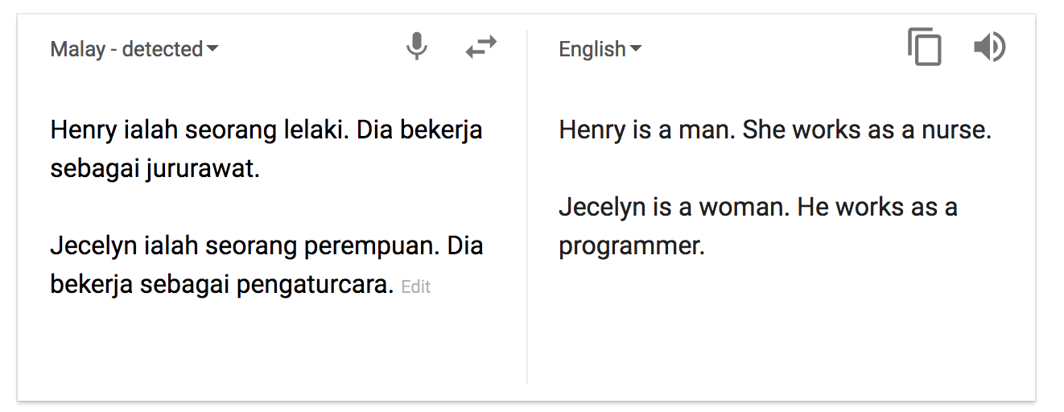
Algorithmic Bias

Slide 21
“Neural Information Processing Systems”
NIPS → NIPS
NIPS → Neurips

Slide 22
Sometimes Changing things means thinking non-algorithmically

Slide 23
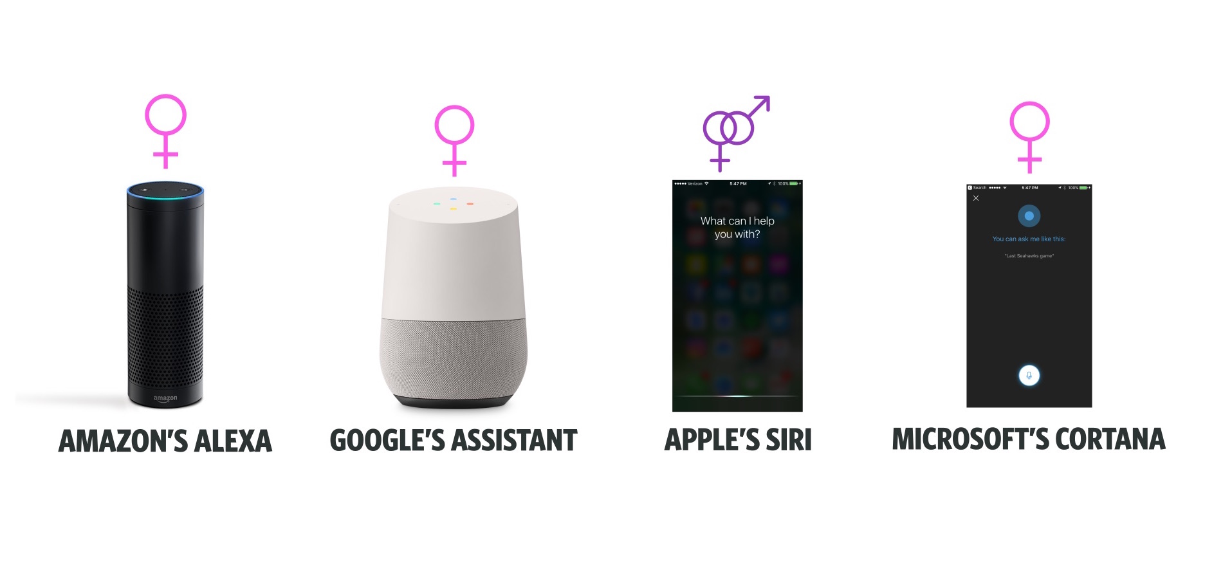
Notes:
UNESCO report: “I’d blush if I could”
"Because the speech of most voice assistants is female, it sends a signal that women are... docile helpers, available at the touch of a button or with a blunt voice command like 'hey' or 'OK'. The assistant holds no power of agency beyond what the commander asks of it. It honours commands and responds to queries regardless of their tone or hostility," …
"In many communities, this reinforces commonly held gender biases that women are subservient and tolerant of poor treatment."

Slide 24


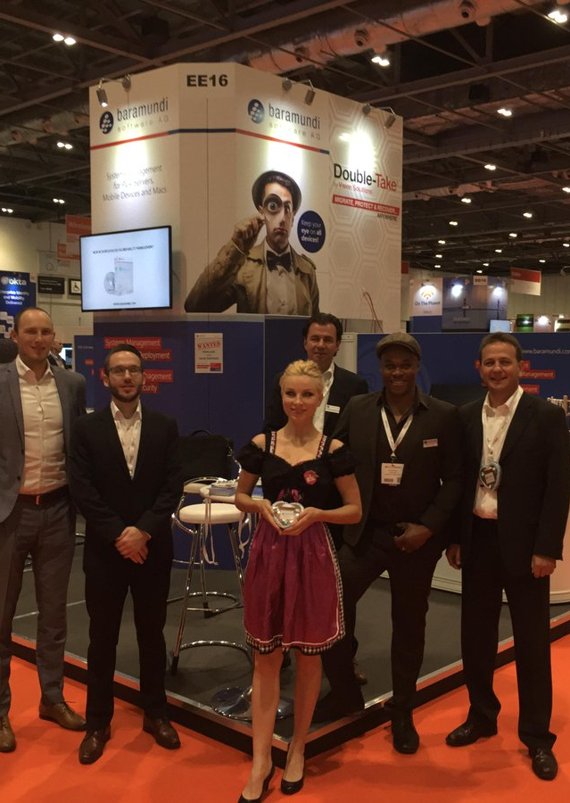

Booth Babes

Slide 25
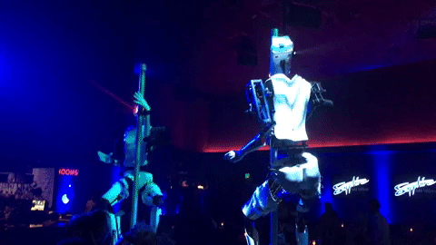
Robot Strippers at CES 2018
Notes:
Hostile spaces – Consumer Electronics Show

Slide 26
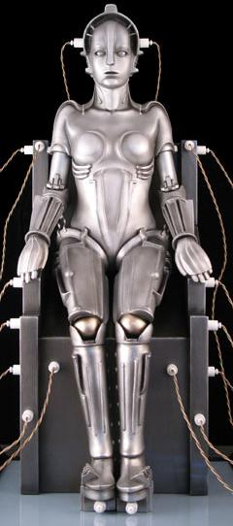


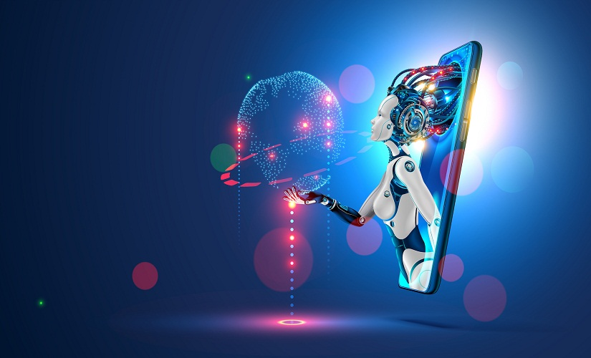

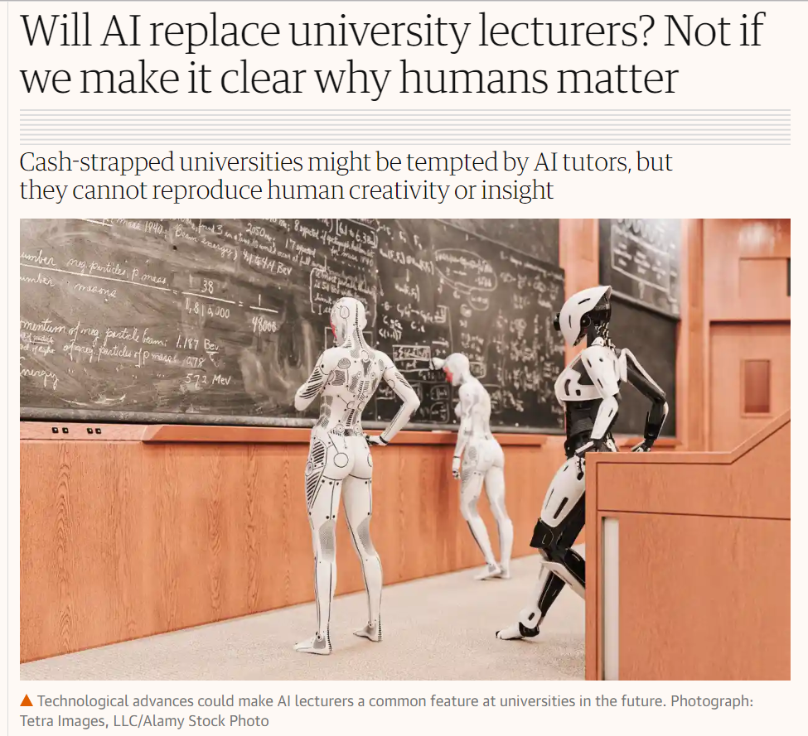
Notes:
Sexy lady robots – hostile narratives

Slide 27
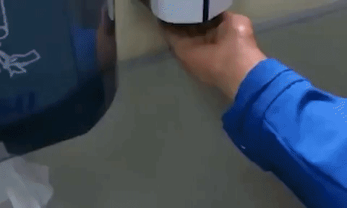

Slide 28
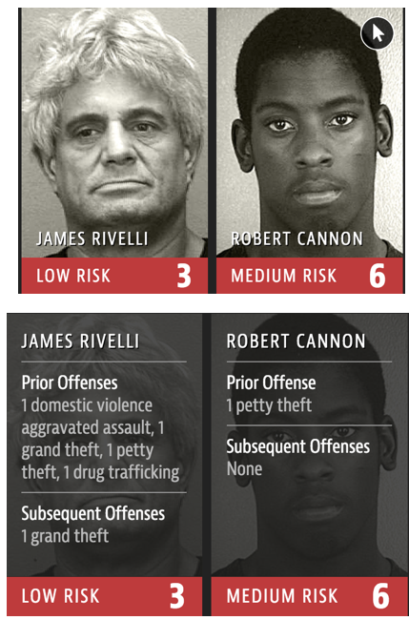

Slide 29
3. What Will Change Because of AI?

Slide 31
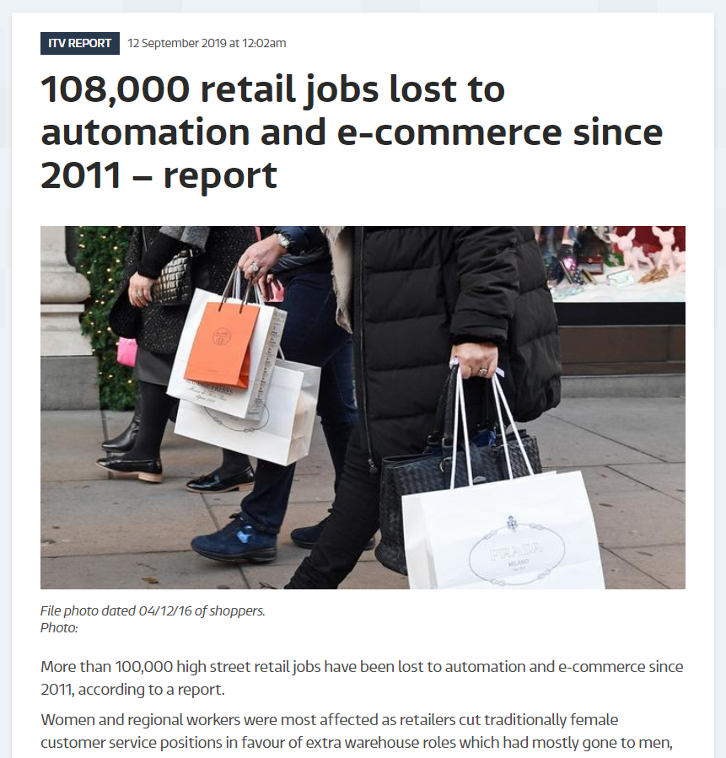

Slide 32

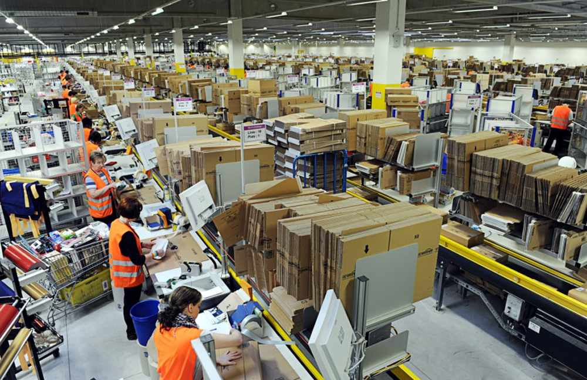
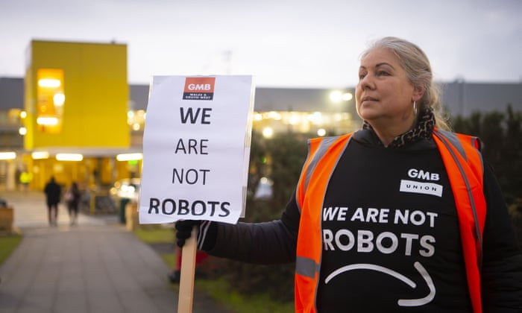
Robomorphisation: Treating Humans Like Machines

Slide 33
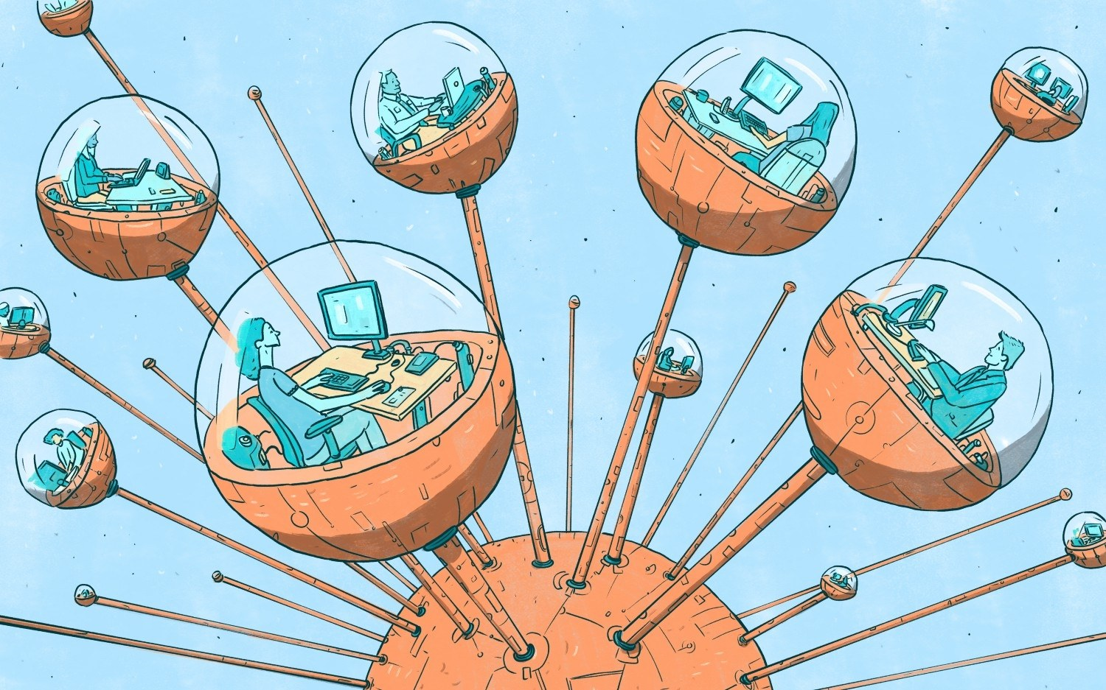

“When Manish Bhatia began working on Amazon Mechanical Turk as a side gig in 2010, he was surprised to find himself completely fascinated by the work. Contrary to frequent coverage depicting the piece-work platform as a digital sweatshop offering low-skill tasks, he thought the microtasks were intellectually stimulating. Many involved training machine-learning algorithms to do things like make purchasing recommendations based on past behavior or categorize content by genre; Bhatia enjoyed thinking of himself as the “AI behind the AI” and knowing that he was doing something to shape the future. The only problem was that he wasn’t getting paid.”
WIRED, 23rd August 2017

Slide 34

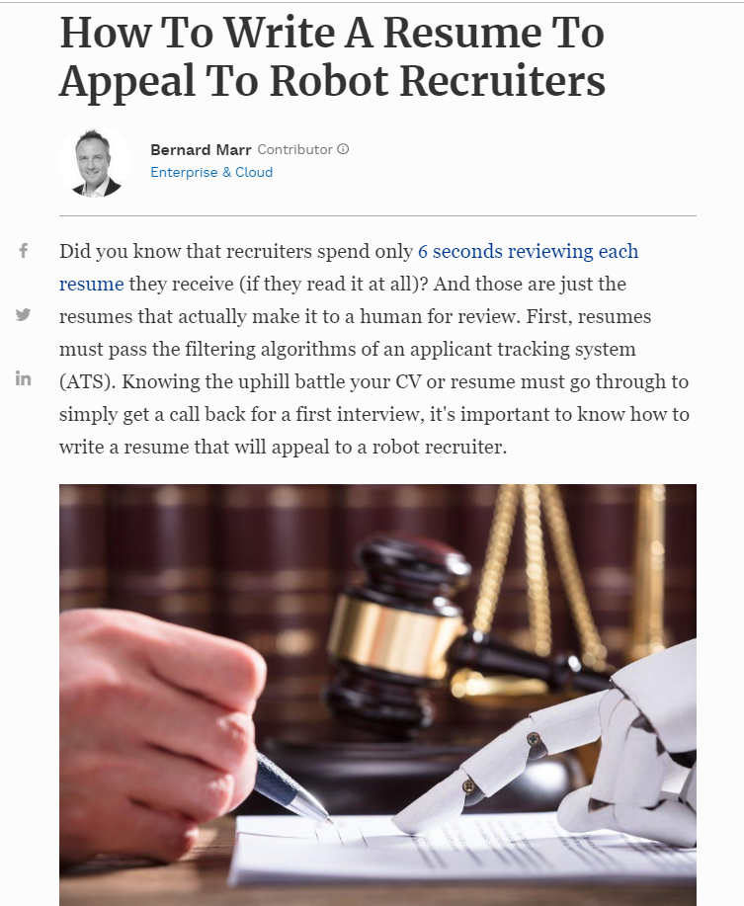
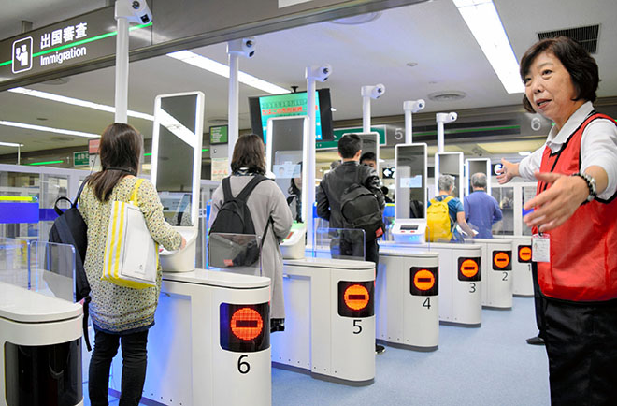
Retrofitting the Human
Behaving to suit the system/machine/AI rather than the other way around

Slide 35
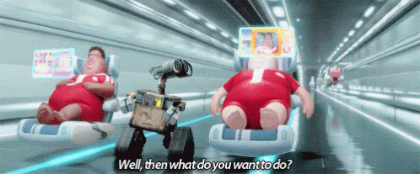
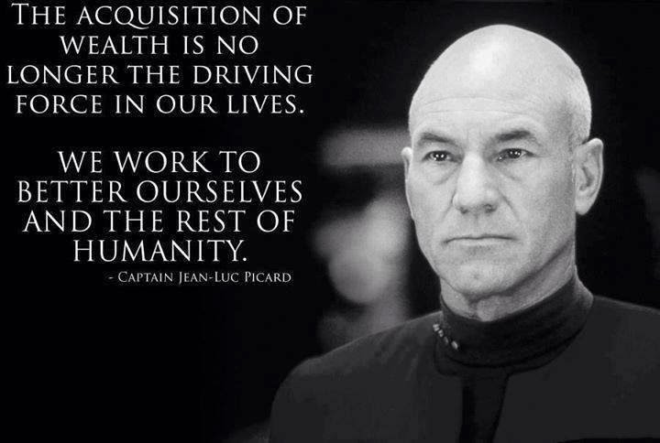
THE FUTURE OF WORK
How is the post-work future imagined?
The dangers of EASE vs OBSOLESCENCE
Or… the danger of EASE AND OBSOLESCENCE
Star Trek Luxury Space Communism or Wall-E?
What is a human being for?

Slide 36
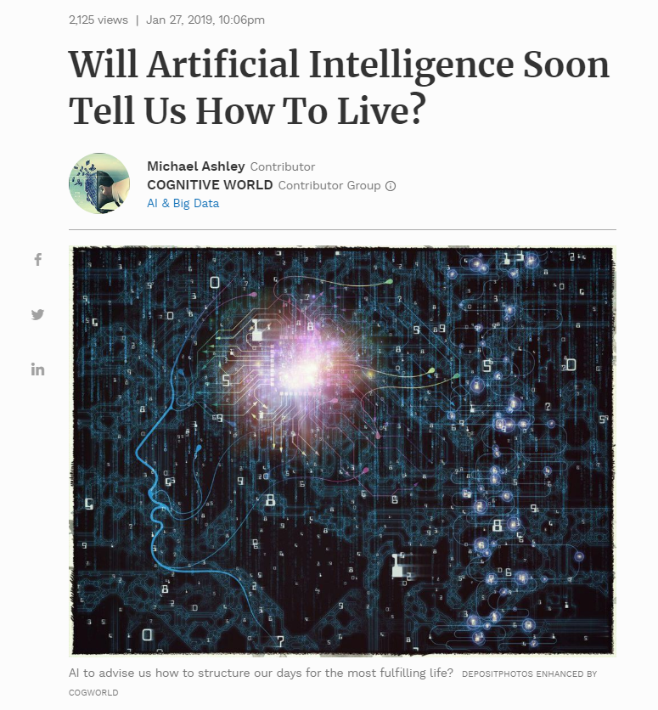
“What people don’t realize is that we are on the verge of a paradigmatic shift in thinking on par with the Copernican Revolution,” says Dr. Angel Iscovich. “The way we make our most personal decisions—from our partners, to our health choices, to yes, even our daily routines— is going to transform due to the falling cost of data storage and rising computing power.”
[…]
According to him, in the future, AI will advise us how to structure our days for the most fulfilling life. It will literally tell us what to do for optimal living.

Slide 37
4. Will the robots kill us all?

Slide 38
No.

Slide 39
4. Will the robots kill us all?
No.
But…

Slide 40
4. Will the robots kill us all?
No.
But…
Humans intentionally or unintentionally using robots/AI to reinforce and perpetuate inequality might…

Slide 41

Notes:
Common conception of the AI Apocalypse – Ashes of the Singularity, computer game. Will return to this term.

Slide 42

Notes:
The virality of the idea – in parodies such as in this meme. MEME origin.

Slide 43
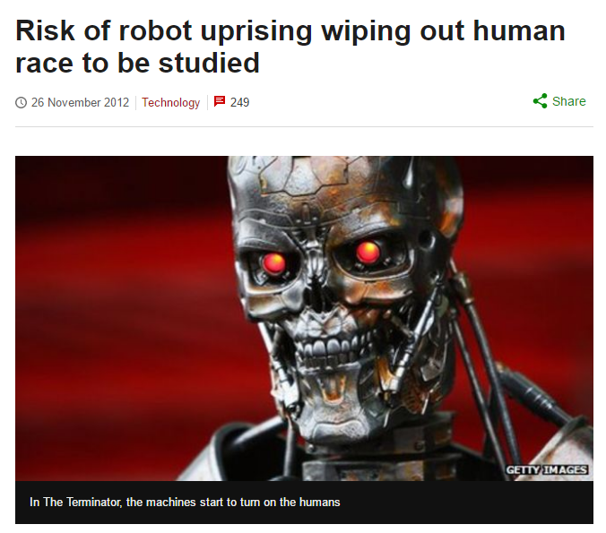
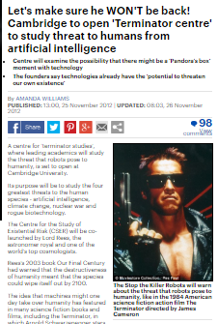
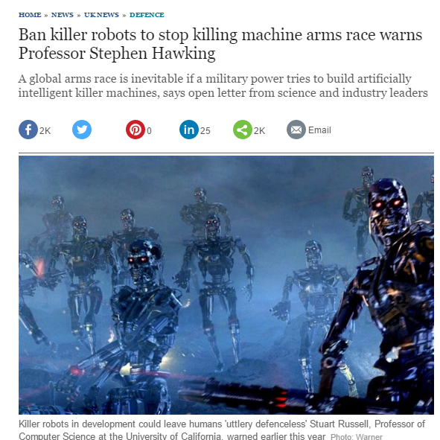
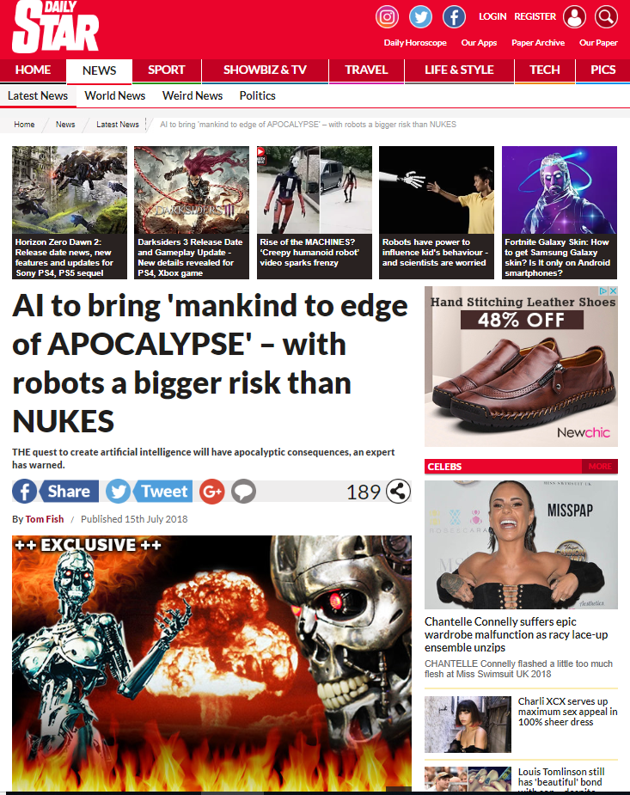
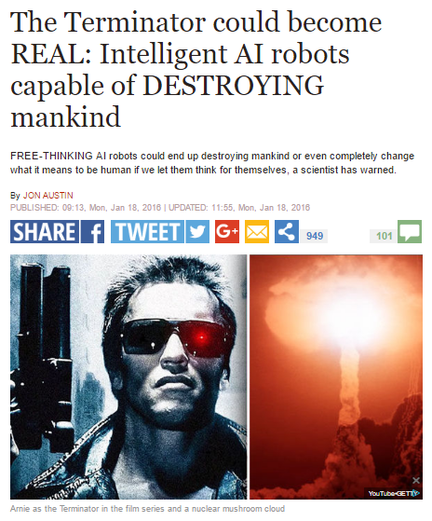
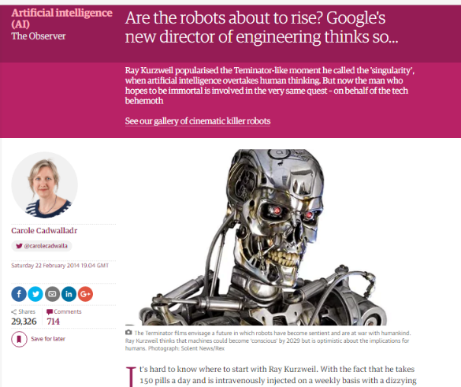
The Terminator in the Press
Notes:
Used slide in previous talk re Moral panics around technology. RE: AI important to understand the stories we tell ourselves about the technology, its abilities, and what will happen to us (eschatology - the Science of Last Things)

Slide 44
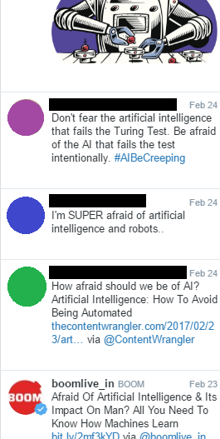
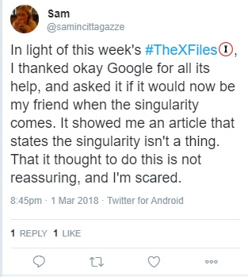
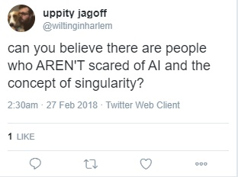
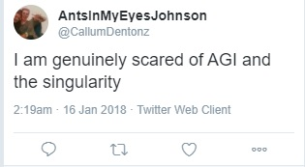
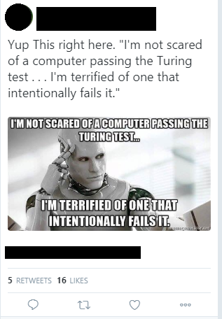
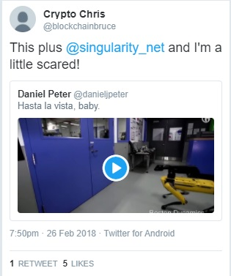
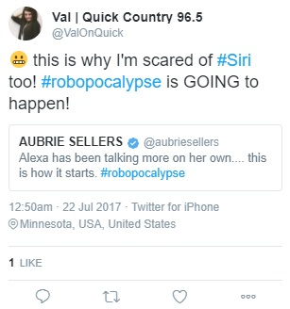
Anthropology of AI Anxiety
Notes:
Have been doing work around an Anthropology of Anxiety with regards to AI and thinking about where does fear of AI come from? Last paper at a CenSamm conference → Zygo Article: “An Ethnographic Discussion of Existential Hope and Despair in AI Apocalypticism”, in Zygon: Journal of Religion and Science. .

Slide 45
Examples of AI Apocalypticism
AlphaStar
‘29 Scientists’

Slide 46
1: ALPHASTAR
*NB Starcraft II was WoN 11-1 by Alphastar on 24th January 2019
*

Slide 47

Notes:
MMR = “Matchmaking Ranking”: determines what opponents you will be facing, the system puts you against players with similar MMR of yours. Higher = the better player you are
5:0 win versus ‘TLO’
5:1 win versus MaNa (one match where it couldn’t see whole map and lost…

Slide 48





Responses to AlphaStar
Notes:
Fear and Trust RE: AI

Slide 49
Responses to AlphaStar
Notes:
Fear and Trust RE: AI

Slide 50

The ‘29 Scientists’ Conspiracy Theory
Notes:
https://www.youtube.com/watch?v=p4y7AkfA8NE
Linda Moulton Howe. She is a ufologist and investigative reporter who began her career writing about environmental issues before focusing on cattle mutilations with the 1980 documentary, Strange Harvest, which received a regional Emmy award in 1981.
This talk was given at the Conscious Life Expo in February 2018, and in it she refers to the death of 29 Japanese scientists at the hands of their own creations in the August of the previous year. She claims that this disaster was hushed up and that a whistleblower had come to her to share the truth. This specific section from her overall talk on the dangers of AI was posted on Youtube on 14th December 2018 with an added frame that said the event had happened in South Korea, even though she clearly says Japan. In tweets since 14th December about the ’29 Scientists’ the details do not vary very much, apart from that mis-location. 29 Japanese scientists were working on AI in robotic forms, were shot by ‘metal’ bullets from them, the robots were destroyed, one of them uploaded itself into a satellite and worked out how to rebuild itself ‘even more strongly than before’.
Epistemic capital (Robertson 2016): getting status from “How we know” – hidden sources leading to influence – having the ‘truth’.
Nb in full version also refers to Elon Musk and Stephen Hawking as experts worried about AI.

Slide 51

2018
Notes:
This is not a huge number of interactions compared to many other viral stories. But I think its an interesting case study: it highlights the nature of the AI expert, who is believed and trusted, charismatic authority, conspiracy culture, AI apocalypticism, and techno-orientalism.

Slide 52

ENCHANTMENT AND THE APOCALYPSE
Notes:
“Enchantment” in the Weberian sense – that society is increasingly disenchanted through rationalization and that humans become less and less significant, as parts of the greater machine of society.
I don’t hold to this – enchantment continues but reaches peaks and hits public attention at different times.
Whenever that happens, enchantment re-centres the human, and makes them aware of a universe of wonder and change rather than the iron cage of disenchantment they presume that they are in.
When AI inspires the dystopic, the apocalyptic, its highlights for us an enchanted world.
Thus that, if this is what we are being presented with… then we, the ones looking at this kind of AI, are in fact this person….

Slide 53

ENCHANTMENT AND THE APOCALYPSE
Notes:
The noble warrior working to save the world. Or perhaps we are more important than that… perhaps we are even…

Slide 54

ENCHANTMENT AND THE APOCALYPSE
Notes:
The Chosen One (John Connor has had the most faces of all the characters in the series, so perhaps is the best platform on which for us to write our aspirations to be the heroes of our own AI apocalypse?)

Slide 55
AFTER THE APOCALYPSE
“For now, the worst has been faced and it wasn’t so bad after all. There was that magic moment of reintegration and safety at the end, that same feeling that comes when the roller coaster stops at the end of its run and you get off with your best girl [or best guy!], both of you whole and unhurt.
I believe it’s this feeling of reintegration, arising from a field specializing in death, fear, and monstrosity [the horror genre], that makes the danse macabre so rewarding and magical”
Stephen King, Danse Macabre

Slide 56
Conclusion
1. What is AI?
2. What is AI doing right now?
3. What changes are likely because of AI?
4. Will the robots kill us all?

Slide 57

Conclusion
1. What is AI?
2. What is AI doing right now?
3. What changes are likely because of AI?
4. Will the robots kill us all?

Slide 58

Contact
bvw20@cam.ac.uk
@BVLSingler on Twitter
Bvlsingler.com

